Slide 1
Sprocket Central Pty Ltd
Data Analytics Approach
Jasdeep Singh Monga

Slide 2
Agenda
Introduction
Data Exploration
Model Development
Interpretation

Slide 3
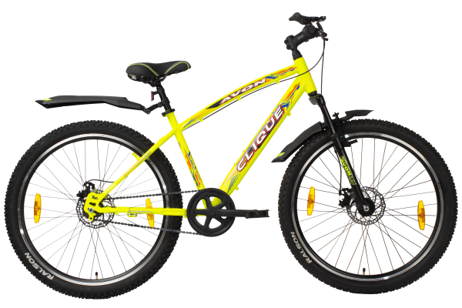
Introduction
Sprocket Central Pty Ltd-Key Undertakings
Bike sales based on Region
Preference among different genders
Busiest Production Line
Analysis based on Job Category and Job Title
Interpretation and Recommendation

Slide 4
Data Exploration
Filtering data to remove any discrepancy present in it and using it for analysis.
Null Values were taken care of using the “Fill Na” method.
Similar values in “City” attribute were combined into 1 single attribute to avoid any duplicate values.
Unwanted calculated fields(columns) were removed which were not adding any value to the data.
”Age” of the customers was calculated using their “Date of Birth” field. In the existing customer base certain customers have an age of almost around 178 years that needs to be taken care of.
Using “group by” function in the Jupyter Notebook we were able to find out maximum purchases in the past 3 years across a state, job title, job industry, wealth segment, gender, age etc.
Data type of every attribute was carefully considered. For “Date of Birth” it was changed to datetime instead of an object.

Slide 5
Model Development
Model Insights:
We will analyze the states where the bikes are in great demand. This will give us a fair idea about the supply and demand.
To break it further, various sectors will be taken into consideration i.e. what sought of customers generally prefer bikes and what is their background implying:
Job Sector
Job Category
Wealth Segment
Gender
Owns a car
3. For both old and new customers we can compare the results of buying behaviour.
4. As, per the results that we interpret we can make interpretations and recommend the organization in areas where to keep a close eye.

Slide 6
Interpretation
Final Analysis:
The data presented shows us that the New South Wales is the leading marketplace for bikes being purchased both for old and the new data.
Females have purchased more bikes than Males.
Under wealth segment, mass customers have purchased the maximum no. of bikes.
Solex is the preferred brand choice.
People who don’t have any car have purchased more bikes in the last 3 years.
As per the previous data, people working in manufacturing category have purchased more bikes whereas the new data suggests the people in Financial Services have taken them over.

Slide 7
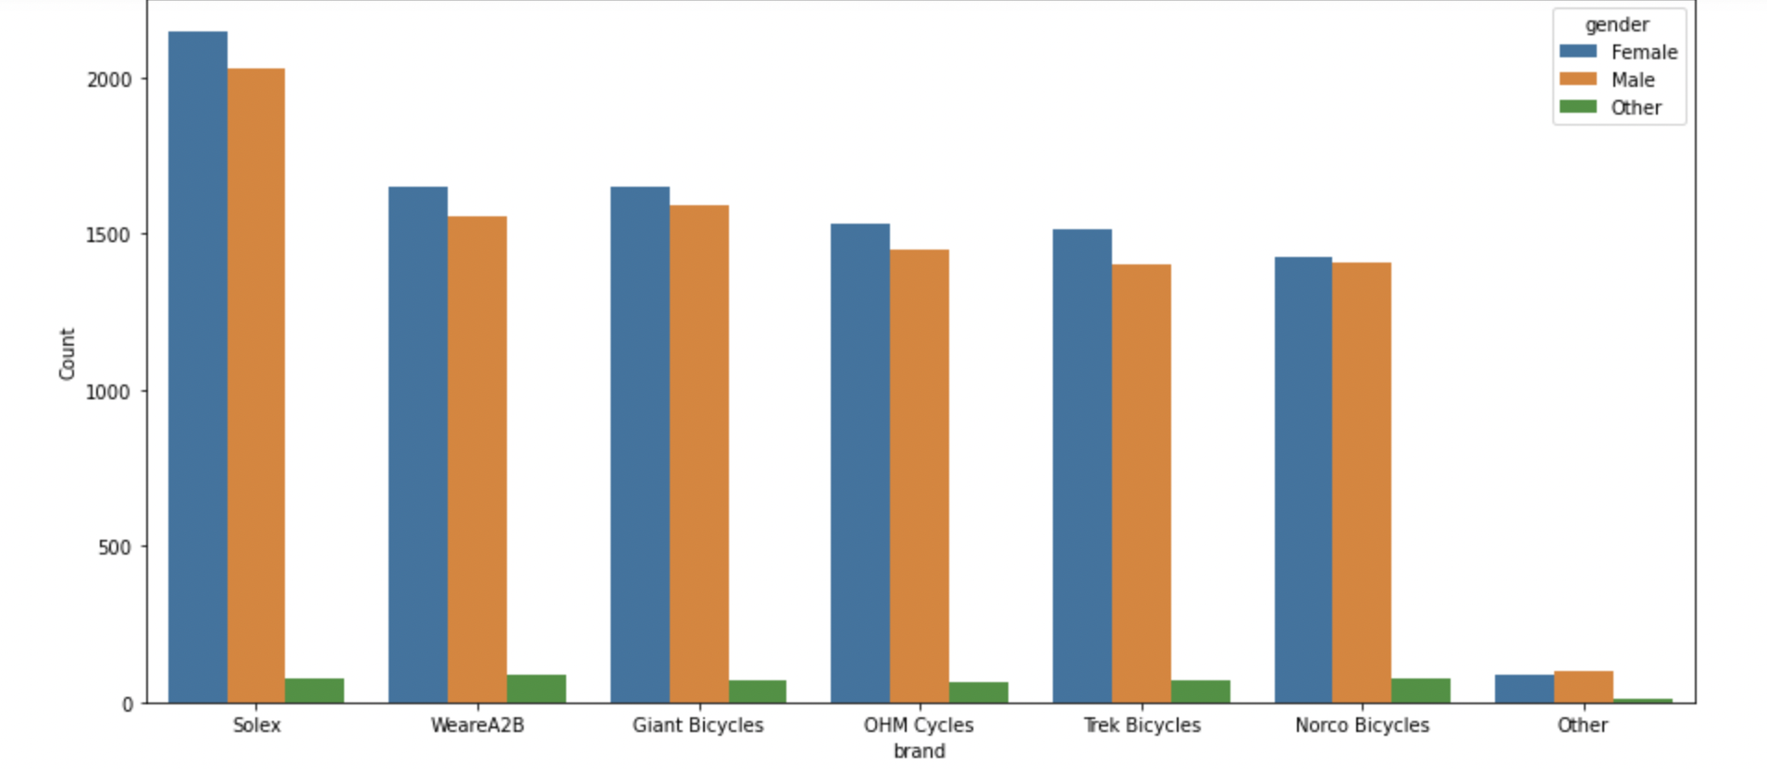
Visualizations
Brand Preference- Among Gender

Slide 8
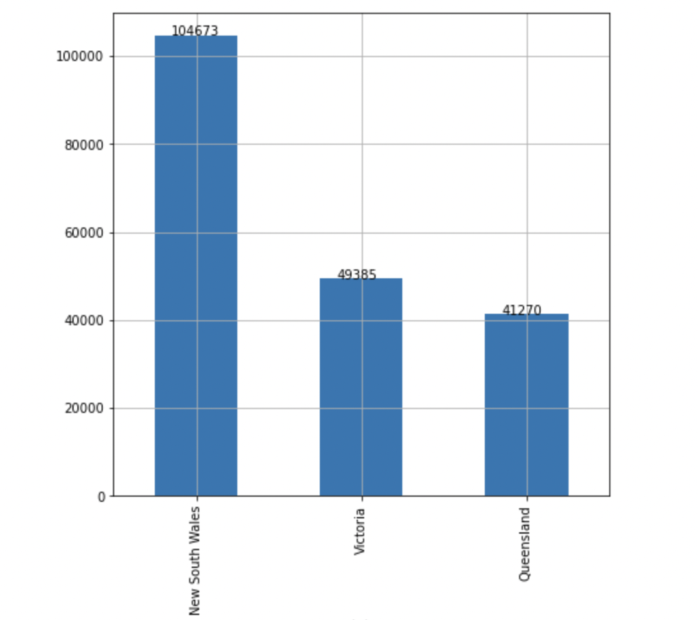
Visualizations
City- Purchase History in last 3 years

Slide 9
Thank You

